Slide 1

S-100WG6
DQWG Report
Agenda item-3.8
Edward Hands, Chair DQWG

Slide 2


DQWG Updates
New Chair and Vice Chair appointed May 2021
Chair: Edward Hands (NO)
Vice Chair : Lingzhi Wu (CN)
DQWG 16 meeting held by VTC 9-10 February 2021.
46 delegates representing 18 Member States -Brazil, Canada, China, Denmark, Finland, France, Germany, India, Indonesia, Italy, Japan, Netherlands, Norway, Portugal, South Africa, Sweden, United Kingdom and United States,
2 representatives of the RENCs (IC-ENC, PRIMAR),
7 expert contributors (IEHG, ISO, NWIC, Portolan Science, SevenCs, Teledyne-Caris and University of New Hampshire)
2 stakeholders (CSMART, INTERTANKO).
2 representatives the IHO Secretariat.
Next meeting – February 8-10, 2022 Monaco/VTC hybrid

Slide 3
DQWG Terms of Reference
Overall Objective: To ensure that the data quality aspects are addressed in an appropriate and harmonized way for all S-100 based product specifications.
Tasks:
Develop and maintain a data quality checklist for product specification developers.
Review S-100 based product specifications for DQ elements.
Monitor developments of ISO and other international standards for DQ aspects.
Provide guidance to HOs on DQ elements.
Provide data quality educational material for the use of mariners.
Review appropriate methodology for the display of quality information to product specification developers.
Propose new data quality topics for consideration by HSSC.

Slide 4
Data Quality Checklist
S-97 IHO Guidelines for Creating S-100 Product Specifications ( Ed.1.0.0 June 2020) Part C Data Quality - based upon the Data Quality checklist that was created by the DQWG.
10 recommendations for the development of S-1xx based Product Specifications.
Completness
Conceptual Consistency
Domain Consistency
Format Consistency
Topological Consistency
Positional Accuracy
Thematic Accuracy
Temporal Quality
Aggregation
Usability
ISO 19157 , Geographic Information – Data Quality

Slide 5
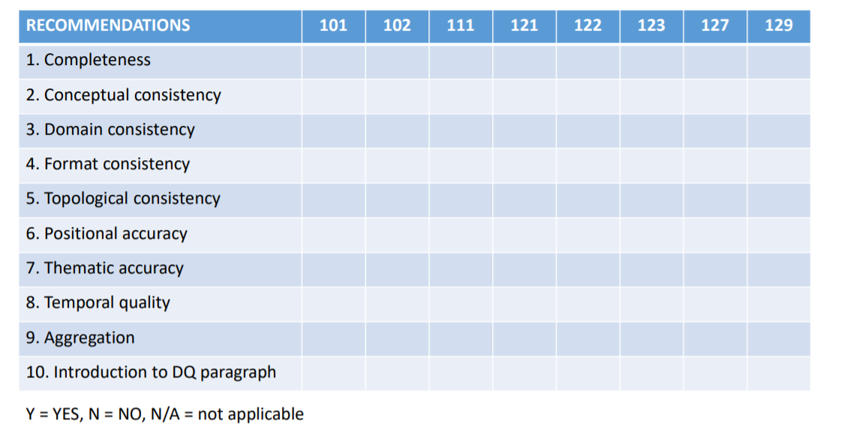
Review S-100 Based Product Specifications For DQ Elements
Primary objective of the DQWG.
A cross check matrix tool is available
A subWG has been established and a review of published Product Specifications is under way.
Results will be shared once ready.

Slide 6
Guidance To Hydrographic Offices On DQ Aspects
Feature Catalogues
Conversion tool developed by NOAA to translate Feature Catalogues to Excel format
- Mandatory items – Normal text
- Optional items – Italic text
DQWG crosscheck different feature classes and highlight potential interoperability issues.
Intial plan to await S-101 FC Ed 1.1.0
Review work will begin on version 1.0.2 of the feature catalogue. (Stable Baseline)
A subWG will be establisehd to work on this review.
Survey to ZOC
SubWG in prosess of drafting a guidance document fot the population of CATZOC /QoDB Values from S-44 Survey Data.

Slide 7
Data Quality Educational Material
S-67: Mariners guide to the Accuracy of Depth Information in Electronic Navigational Charts (Ed 1.1.0 October 2020) – translated into French and Chinese
Proposal from ENCWG Chair to incorporate guidance on ENC generalization, over-scaling and safety checking functions in ECDIS into S-67 – New Name.
Proposal to be considered at DQWG 17

Slide 8
Methodology for the Display of Quality Information
DQWG have been working to develop proposals for the portrayal of quality of bathymetric data.
Implementation by S-101PT Portrayal subWG.
Existing S-52 CATZOC portrayal to be maintain during DF-ECDIS ‘transition’ period.
Development of new portrayal and functionalities for depicting quality of bathymetric data is a priority.

